Slide 1
Hawking Radiation
Lecturer: 張簡崇堯

Slide 2
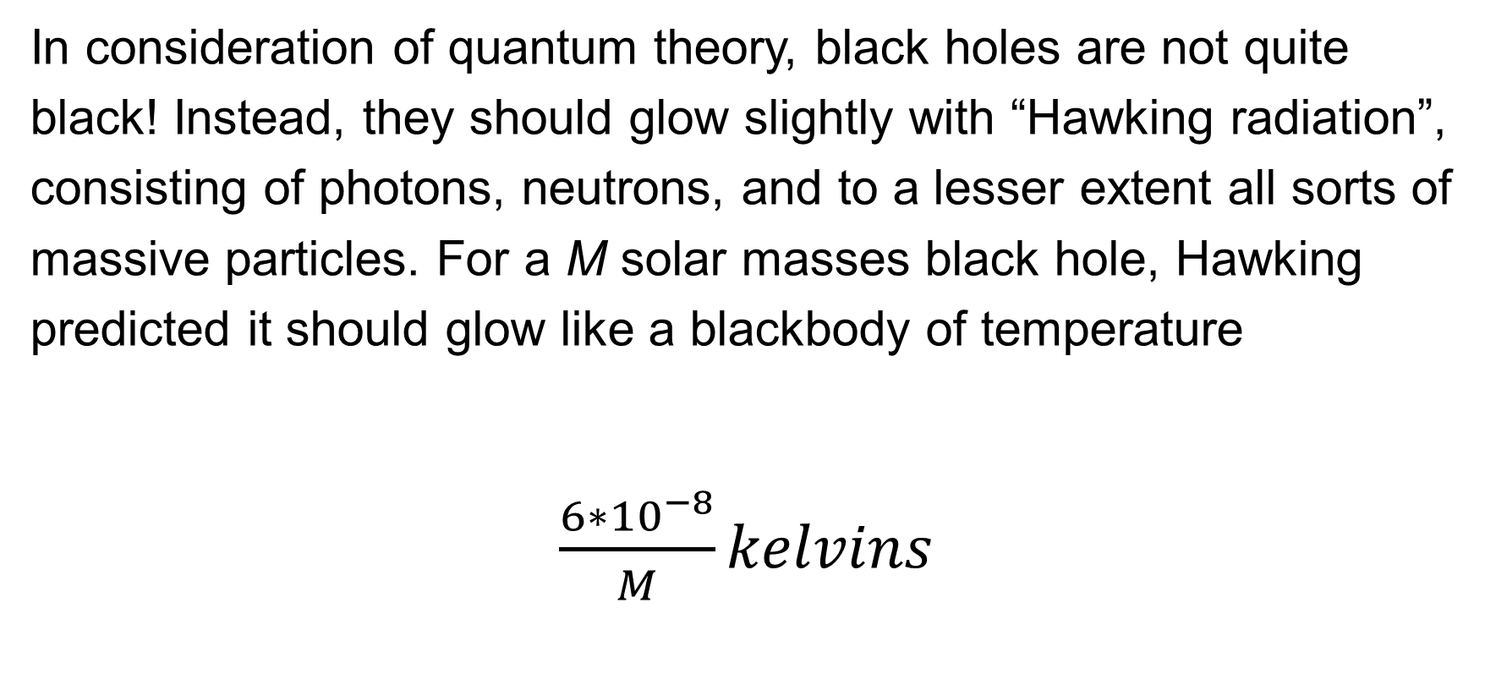
Concept
In consideration of quantum theory, black holes are not quite black! Instead, they should glow slightly with “Hawking radiation”, consisting of photons, neutrons, and to a lesser extent all sorts of massive particles. For a M solar masses black hole, Hawking predicted it should glow like a blackbody of temperature
$\frac{6∗{10}^{−8}}{M}kelvins$

